Slide 1
FORMULA SAE 2018

Slide 2
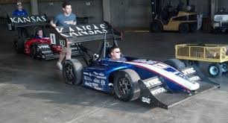
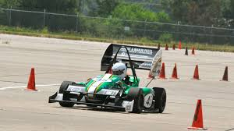
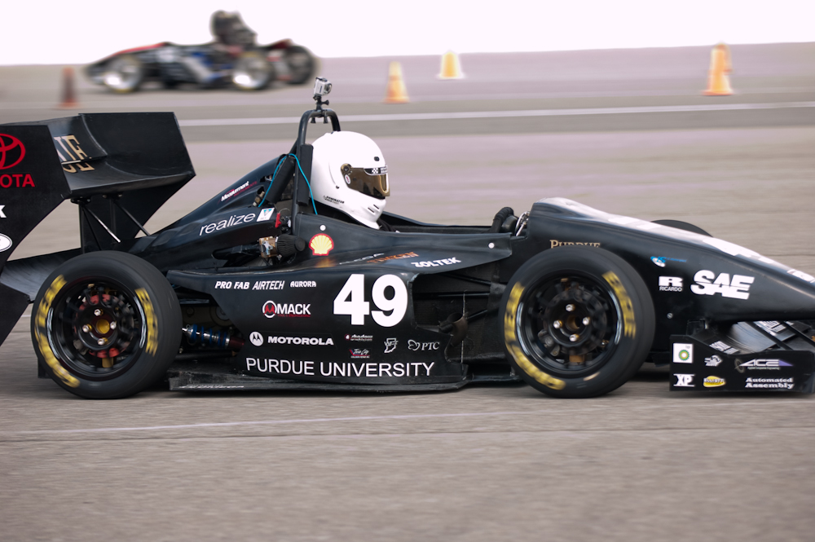
ARGO Design team
Our job is to design, fabricate, test, and demonstrate.
Formula Style Car.
Non Professional “Weekend” race team.
We will be competing to sell our car to a corporation for production
Kansas State
Cal polytechnic
Perdue University

Slide 3
Design Aspects
Performance
Aesthetics
Cost
Ergonomics
Maintainability
Manufacturability
reliability

Slide 4
Points for Competition
Static:
Presentation 75
Engineering Design 150
Cost Analysis 100
Total: 325
Dynamic Events:
Acceleration 100
SkidPad 75
Autocross 125
Efficiency 100
Endurance 275
Total: 675
---1000

Slide 5
Requirements
All Team Members must be registered with SAE International
sae.org/students
Valid Drivers License
Health Insurance
Faculty Advisor
Registration and fees per the SAE website
Possible waitlist(needs to be checked)

Slide 6
Questions?

Slide 7
(General) Specifics
Engine
Frame
Steering
Braking
Coolant
Throttle
Intake
Fuel
Exhaust
Sensors

Slide 8
Engine
(Rule)Max Displacement is 710cc for all pistons
Selected:
2002 GSXR600 Cost and availability
600cc engine displacement
100.6Hp
Fuel Injected
CDI ignition
6-speed constant mesh transmission

Slide 9
Frame
Steel Tube
Monocque (one_coke)

Slide 10
Steering
(Rule) Must be mechanically connected steering
No steer by wire
Steering stops implemented to prevent a bind
Allowable 7degree play
RWS is ALLOWED
Limited to max 6degrees

Slide 11
Braking
Four wheel braking
No Brake by wire
Brake light triangle or near round
Two independent hydraulic circuits for safety
Brake Over Travel switch
BSE Braking system Encoder
Checking brake pedal position
If implausible for greater than 100ms ETC shut down

Slide 12
Coolant
Water only
Sealed

Slide 13
Throttle
Carb or Throttle Body
Mechanically or Electronically
Hybrid
Return Springs
Must have two TPS with a verification shutdown
If implausibility between is greater than 10% for more than 100ms the throttle must shut off.
Two APPS, Acceleration Pedal Position Sensor (same criteria)

Slide 14
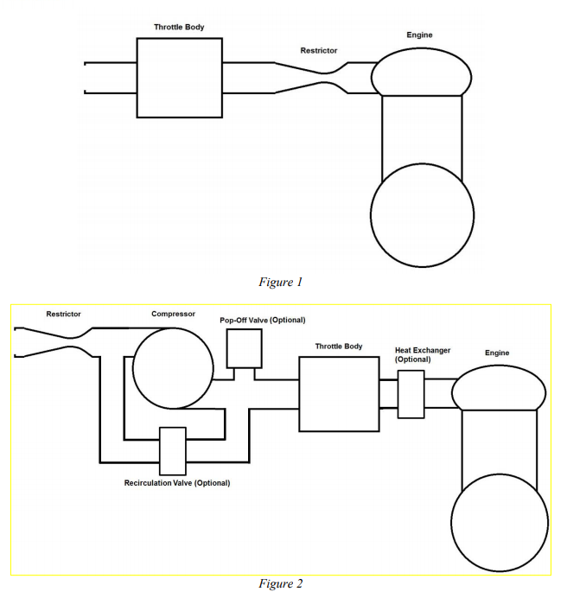
intake
Restrictor
20mm
Intercooler is permitted
Ambient air only
No plenums

Slide 15
Fuel
Specific fuel designed fittings and hoses are permitted
Min 91 octane
The organizer provides fuel
No additives
No temperature changes
Sight tube on filler neck
Any size tank
Vent

Slide 16
Exhaust
No fumes for the driver at any time or any speed
No header wrap
Noise must be limited to max 110 dB
Measured by a microphone placed by the exhaust outlet

Slide 17
Sensors
Required:
2x TPS
2x APPS
BSE
Needed:
Airflow(intake)
Exhaust(flow)
Engine Parameters
Suspension (Force, Travel, angle)
SPEED
RPM
Digital control

Slide 18
Question?

Slide 19
Documentation
YAY!
English majors?
Cost Report
BOM
Cost Tables
Made or bought?
Penalties for bad reporting based on cost of part
Drawings, part tooling cost, Fastener Installation,
Standard part numbering Appendix s

